Slide 1
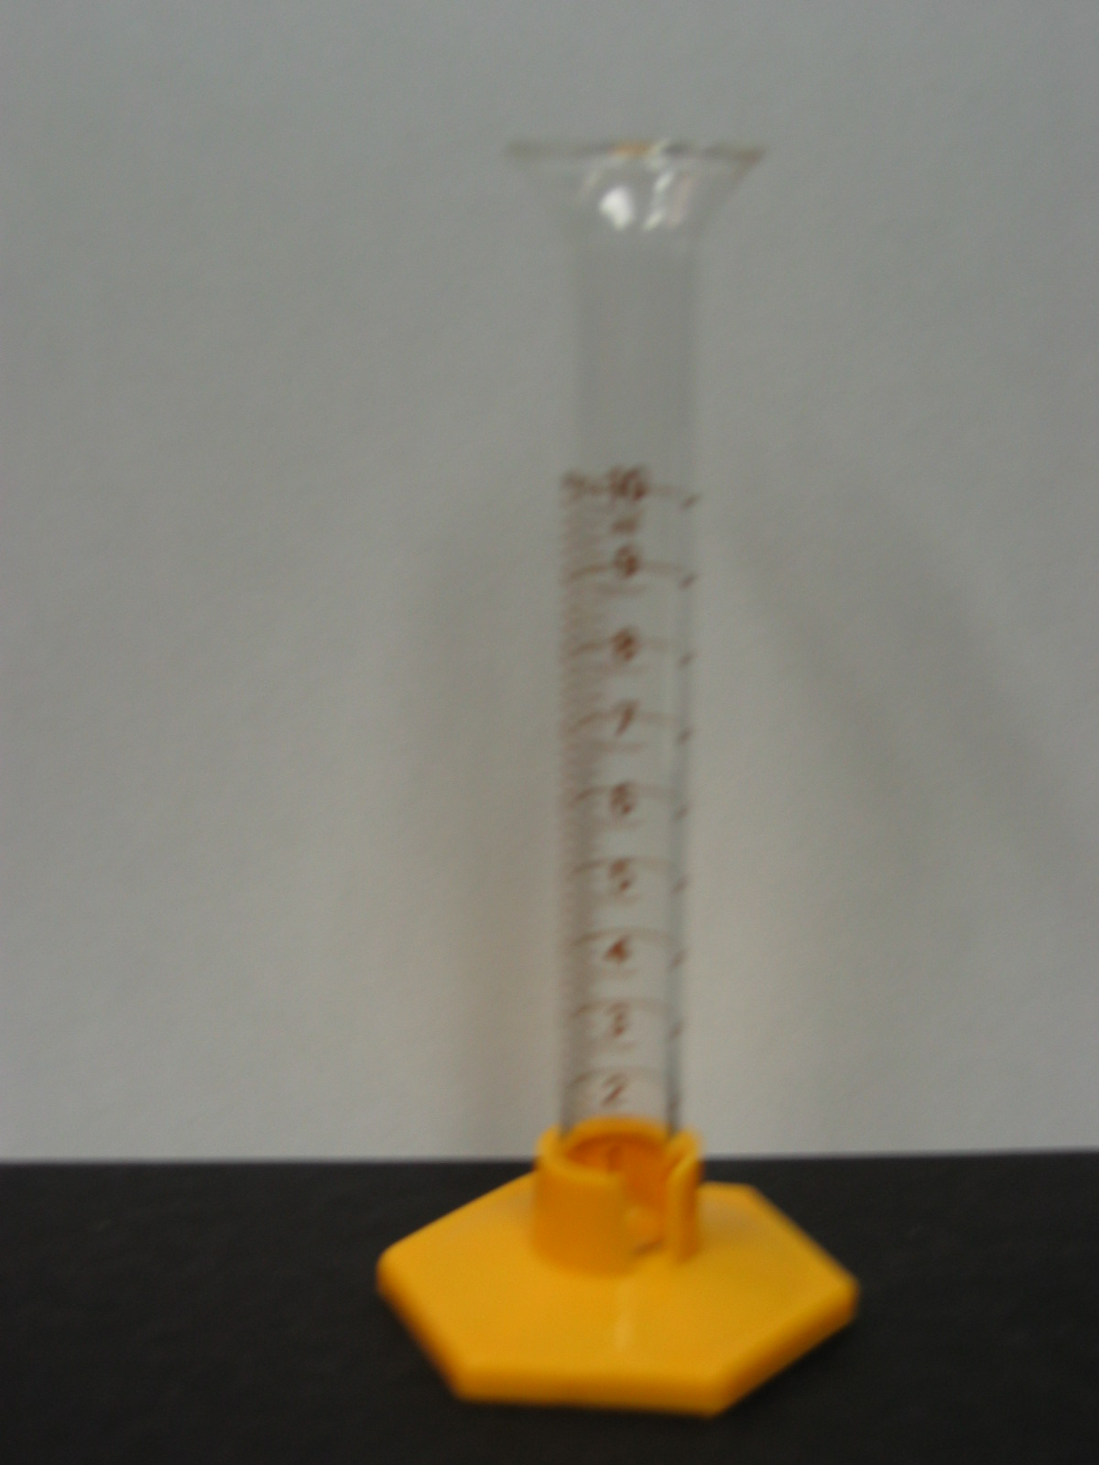
Measurement of Volume
VOLUME is the amount of space that something takes up.
A MEASURING CYLINDER is used in the laboratory to measure the VOLUME of liquids.
Measuring cylinders come in different sizes. They are all marked in units called millilitres (mL).
1000mL = 1 L.

Slide 2
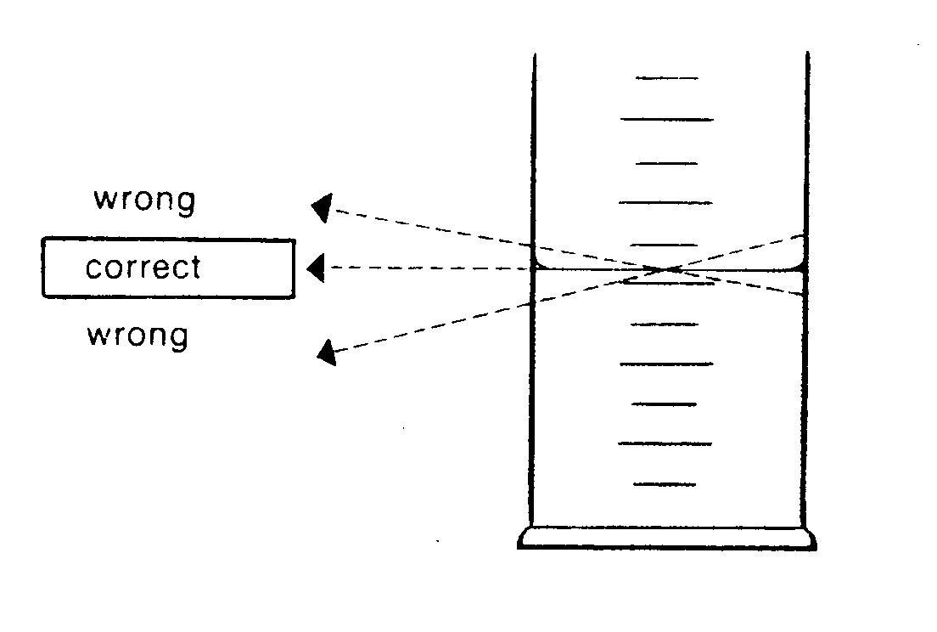
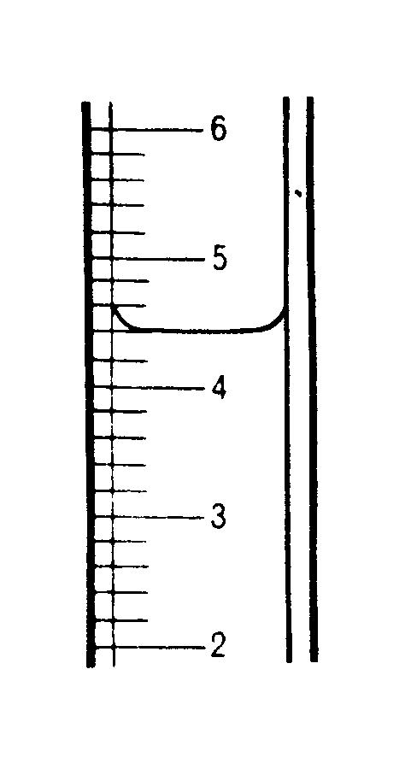
When using a Measuring Cylinder:
Stand the cylinder on a level surface.
Move so that your eye is in line with the level of the liquid.
Read the level of liquid from the bottom of the MENISCUS if it is curved as shown in the diagram.
meniscus

Slide 3
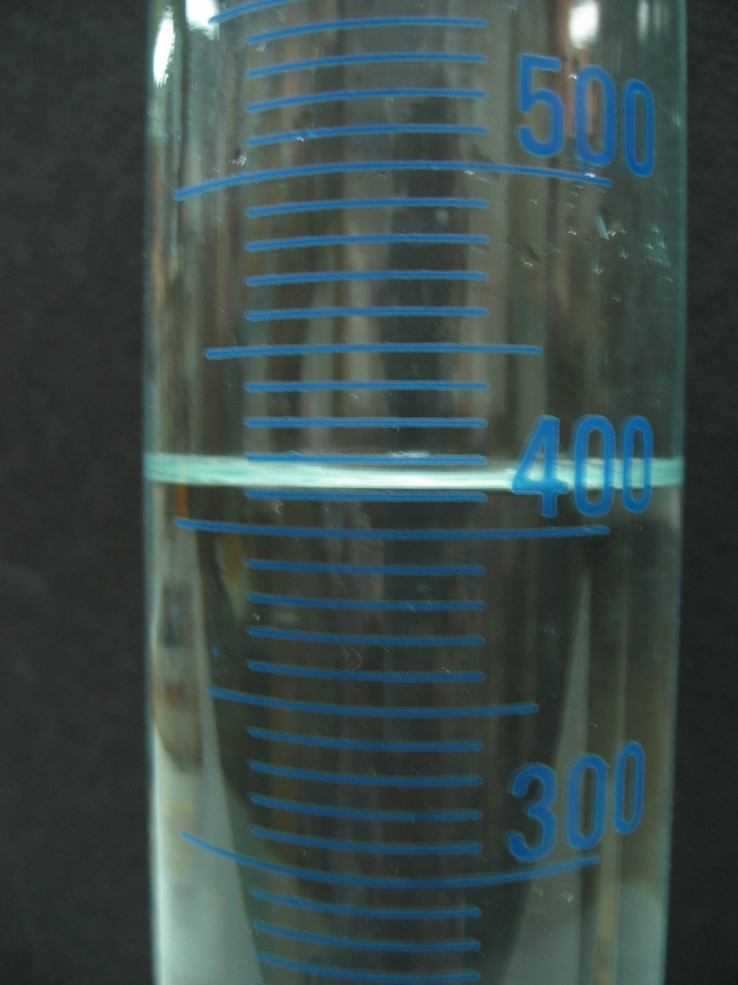
Particles of the liquid are attracted to the glass of the measuring cylinder and “creep up” around the edges.
This forms a meniscus.

Slide 4
What is the volume of liquid in this measuring cylinder?
4.4 mL

Slide 5
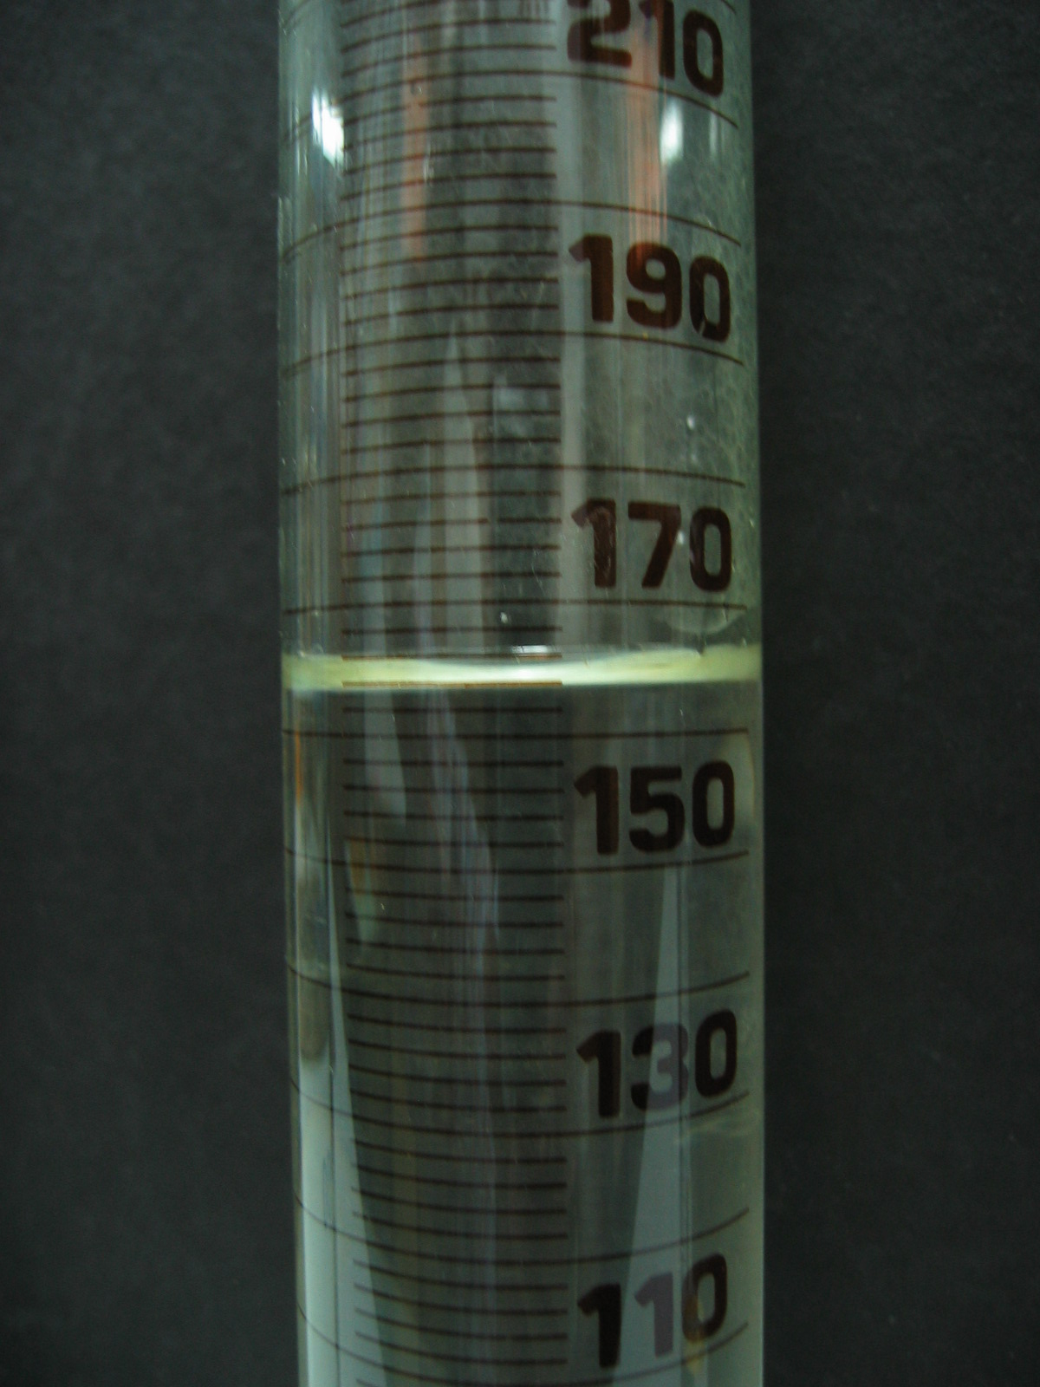
What is the volume of liquid in this measuring cylinder?
164.0 mL

Slide 6
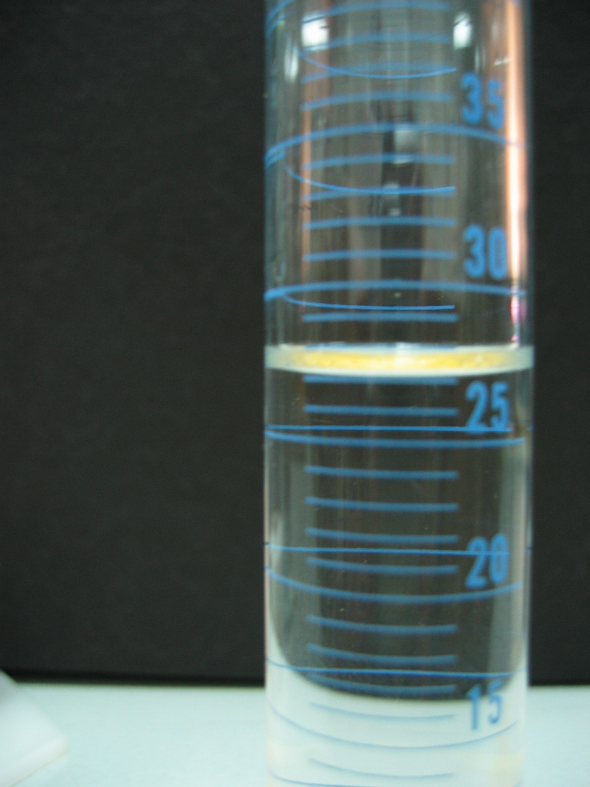
What is the volume of liquid in this measuring cylinder?
27.0 mL

Slide 7
What is the volume of liquid in this measuring cylinder?
410.0 mL

Slide 8

How many did you get right?
Now it’s time to practise on the real thing!

